Slide 1
Database library
A good Altium environment

Slide 2
Intro
A database housing components and making them available in Altium for designs are wanted for its centralized way of working. It can minimize the risk for duplicated work, increasing chance of sharing and hopefully the quality of the designs.

Slide 3
Database Library
Databases can be realized using multiple methods.
A Microsoft excel file will be used but a more dedicated database setup could ease the work.
An offline solution is implemented

Slide 4
Database Library for Altium
The database contains dedicated entries and parameters for each component.
All entries and parameters will later be mapped in a .DbLib file in Altium

Slide 5
Database Excel
An excel file where each column is a parameter and each row a component is used.
All parameters must not have values
Not all parameters must be mapped to the Altium library
There are two parameters that must be present for a component to exist: Library Ref -> Pointing at the Schematic symbol Footprint Ref -> Pointing at the footprint

Slide 6
One must specify the path to the place where symbols and footprints are placed (if not in the same folder as the DbLib file).
Library Ref -> Pointing at the Schematic symbol -> path Footprint Ref -> Pointing at the footprint -> path
Open .DbLib
Go to Tools menu, select Options… then select “Symbols & Model Search Paths”.

Slide 7
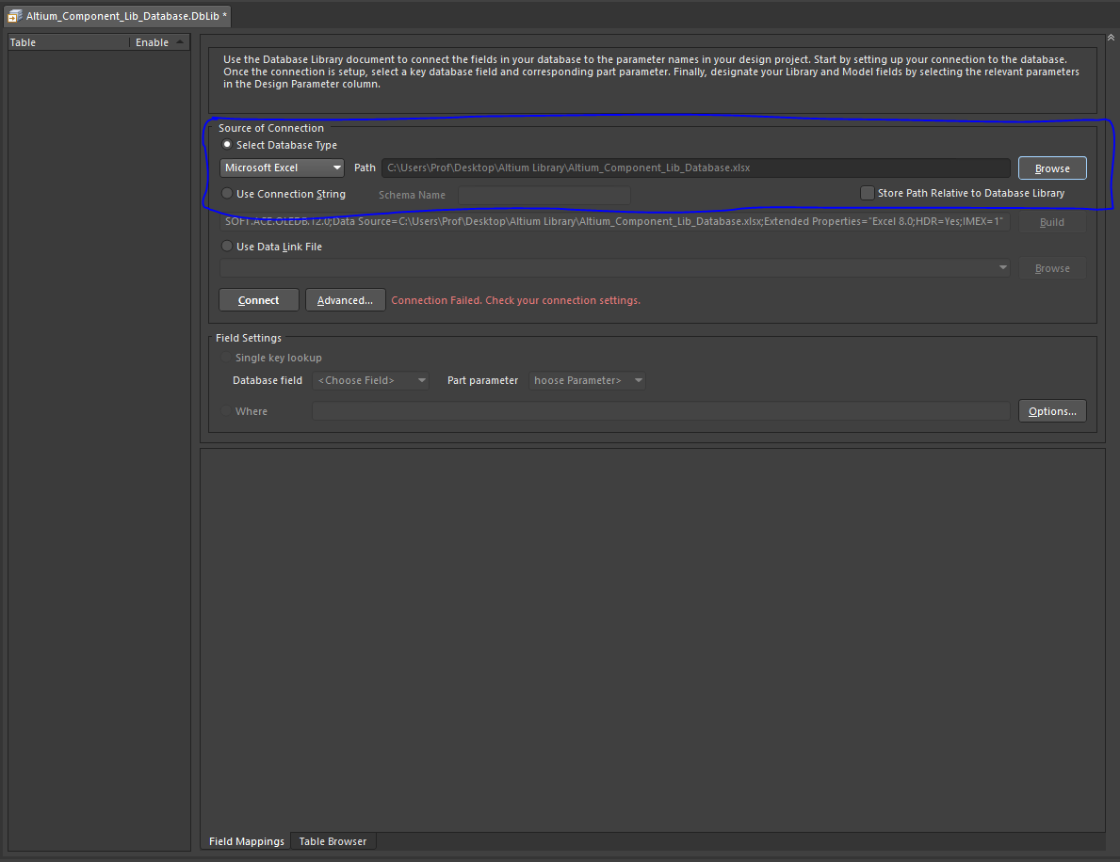
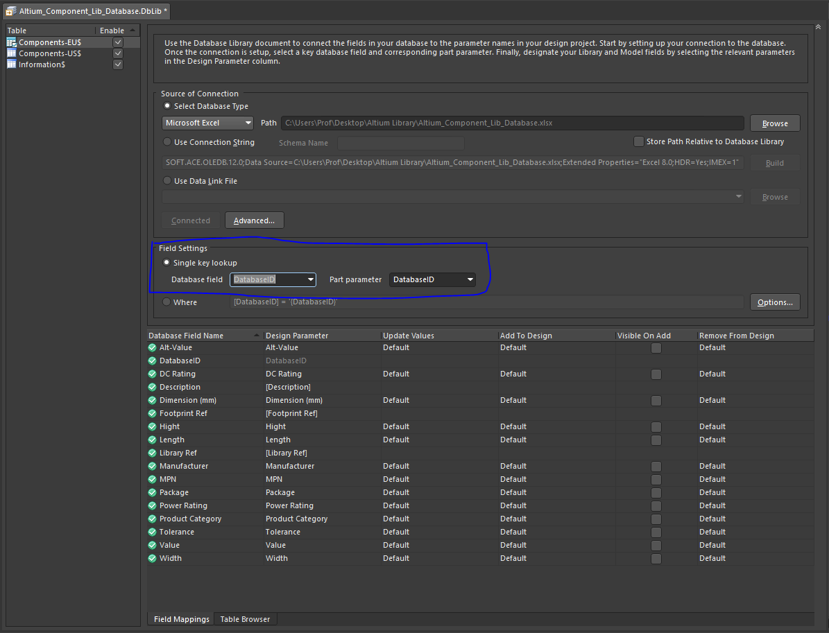
.DBLib
Select Database type and browse to it.
Do the field setting Make sure all Database field names are mapped to correct Design Parameter

Slide 8
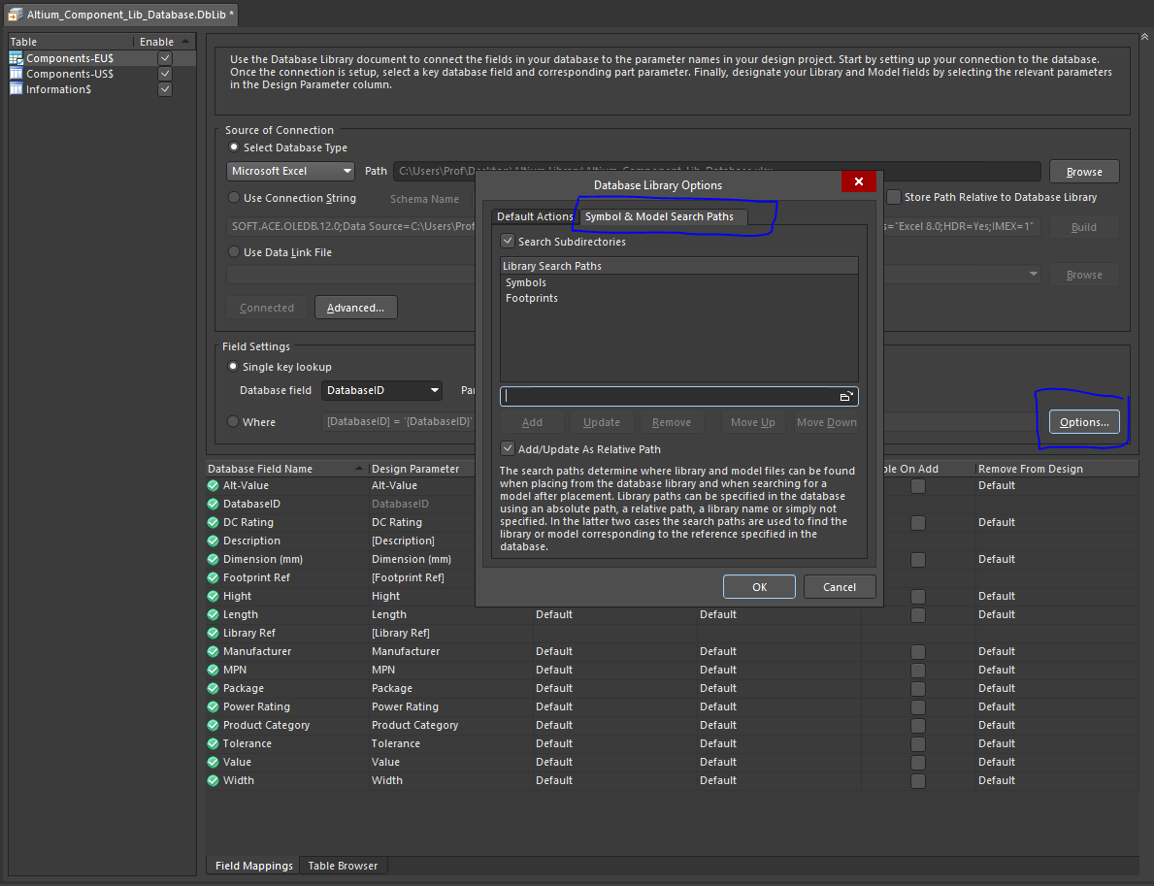
.DBLib
Setup path to Footprints and Symbols

Slide 9
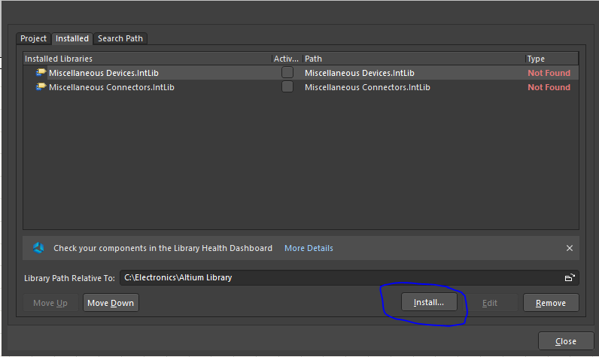
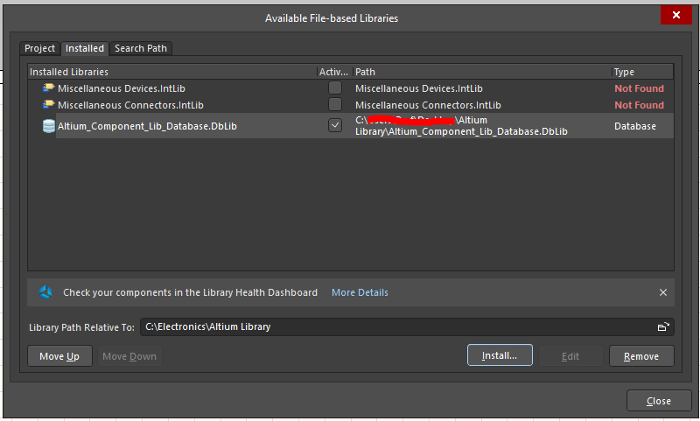
Install .DBLib
The library must now be installed
Navigate to Component panel or System Preferences
Select “Install…” and select .DBLib-file

Slide 10
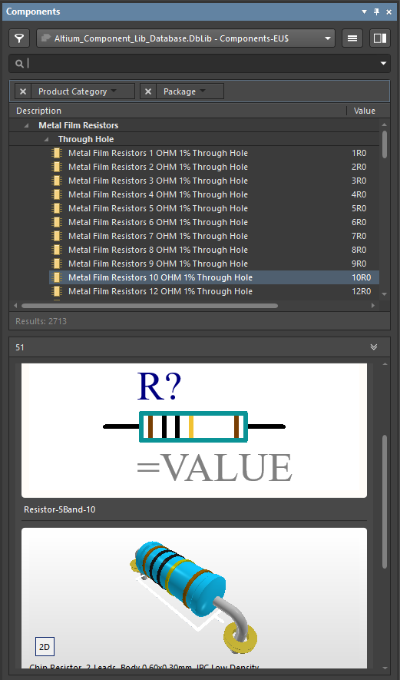
Library
Library installed
Components available for usage

